Slide 1


DANIEL GOMEZ
BUSINESS CASE

Slide 2
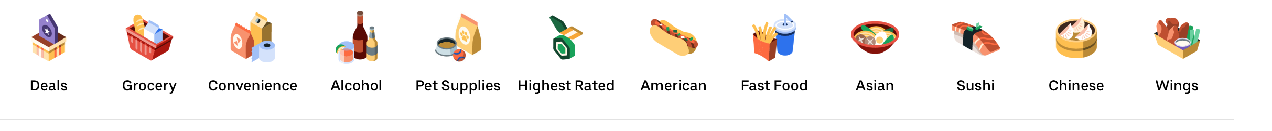



About Me
About me
Achievements
Task 1
Task 2
Valencia
Marketing in L’oreal
Industrial Engineering
Master In
Management
Data Analytics
Ironhack
Sales and Analytics
in Bloomberg

Slide 3


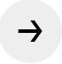
Achievements
About me
Achievements
Task 1
Task 2
Ironhack Final Project
API Data Extraction
Web Scrapping
BQL (Bloomberg Query Language)
DISCOUNTED CASH FLOW
Python (Pandas and other libraries)
CALCULATOR
Streamlit App

Slide 4





Task 1
About me
Achievements
Task 1
Task 2
Business Structure
Eaters
Restaurants
Couriers
Number of Restaurants
Launch day
Number of couriers

Slide 5
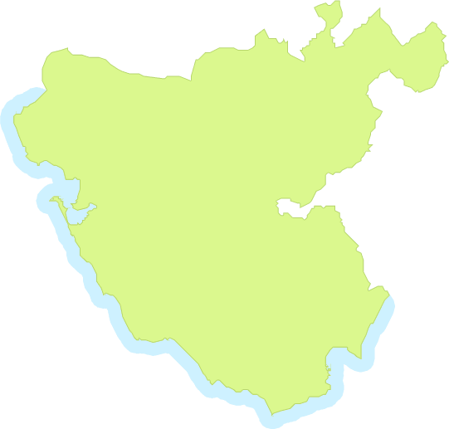
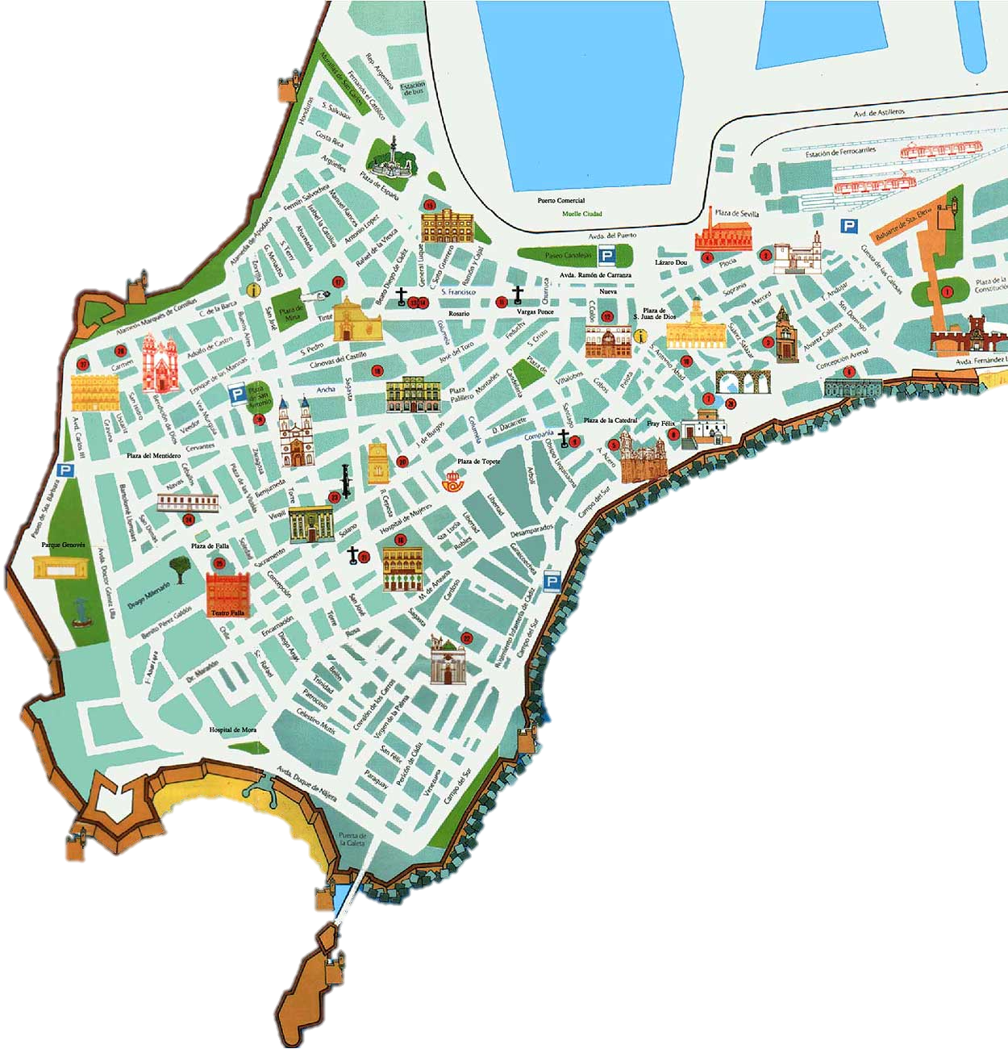


Task 1
About me
Achievements
Task 1
Task 2
Cádiz
Population of 116,979 (2018)
Target population: 34,185 (age 18-38)
Max distance bike 20/25 mins
Average salary 16,572 €/year
Important city events:
- Pestiñá (January)
- Carnaval (February)
- Semana santa (14-21 April)
Uber rides already present
Delivery competitors

Slide 6
Task 1
About me
Achievements
Task 1
Task 2
Metrics
Objective pre-launch
1000 EATERS
12 weeks
New Eaters/week
90
Average basket size
17 €
17 RESTAURANTS
Average orders/week
1
12 COURIERS
New Restaurants/week
2
Launch Day:
25th of March
Average order size
17 €
Assumptions
New couriers/week
3
- 14 delivery periods (3x hours) / week
Number of orders/hour
3
- Max travelling distance in Cádiz 25 min
- 40% of orders during weekends
90
- Campaign starts second week of Jan 2019
Orders/delivery period

Slide 7
Task 1
About me
Achievements
Task 1
Task 2
84 eaters/ courier
56 eaters/ restaurant
Customer growth:
-100/week +5 extra per month
4 weeks to obtain +ive operating profit

Slide 8


Task 1
About me
Achievements
Task 1
Task 2
Growth Strategies
Activation through UberX clients
Partnerships with popular Chains/ restaurants
- Increase Brand awareness
Partner with restaurants with own delivery:
- Reduce number of couriers needed
- Increase availability
- Improve customer service
Client retention through promotions and special offers
- Customized offers
- Special events (football matches, concerts….)
Popular holidays
- Semana Santa
- San Juan
- Carnavales

Slide 9
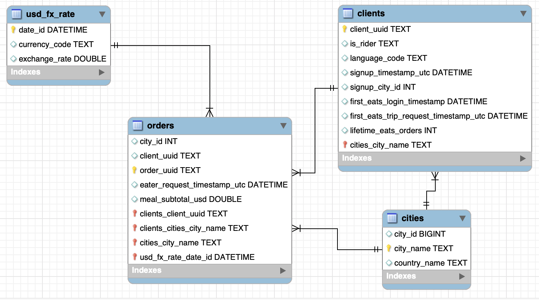
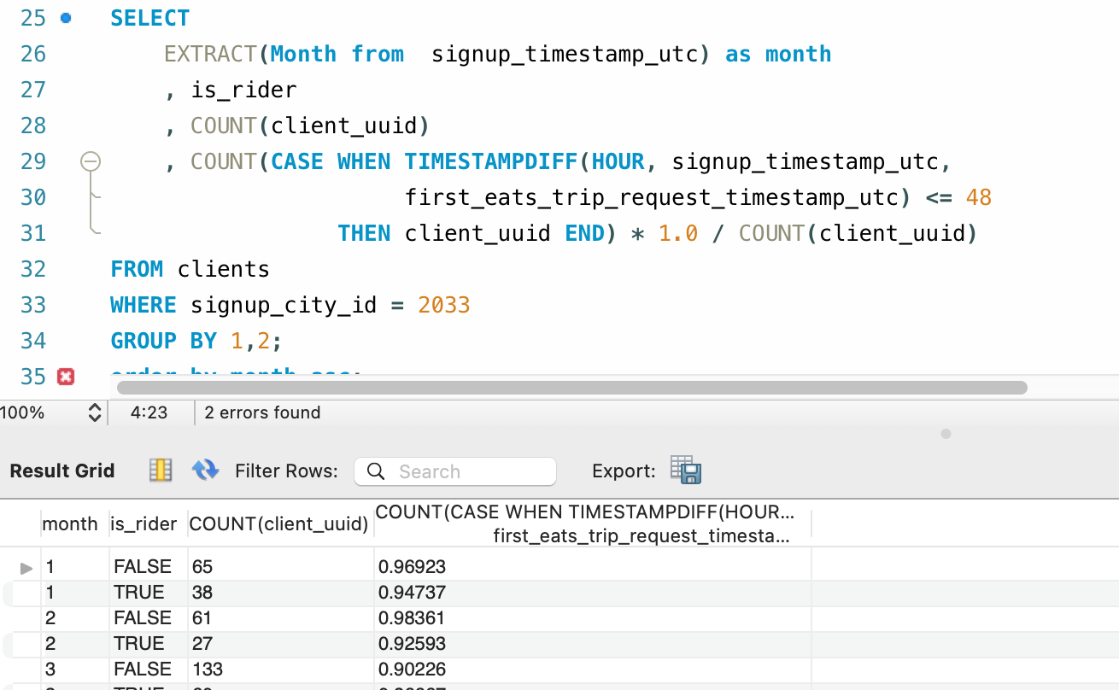
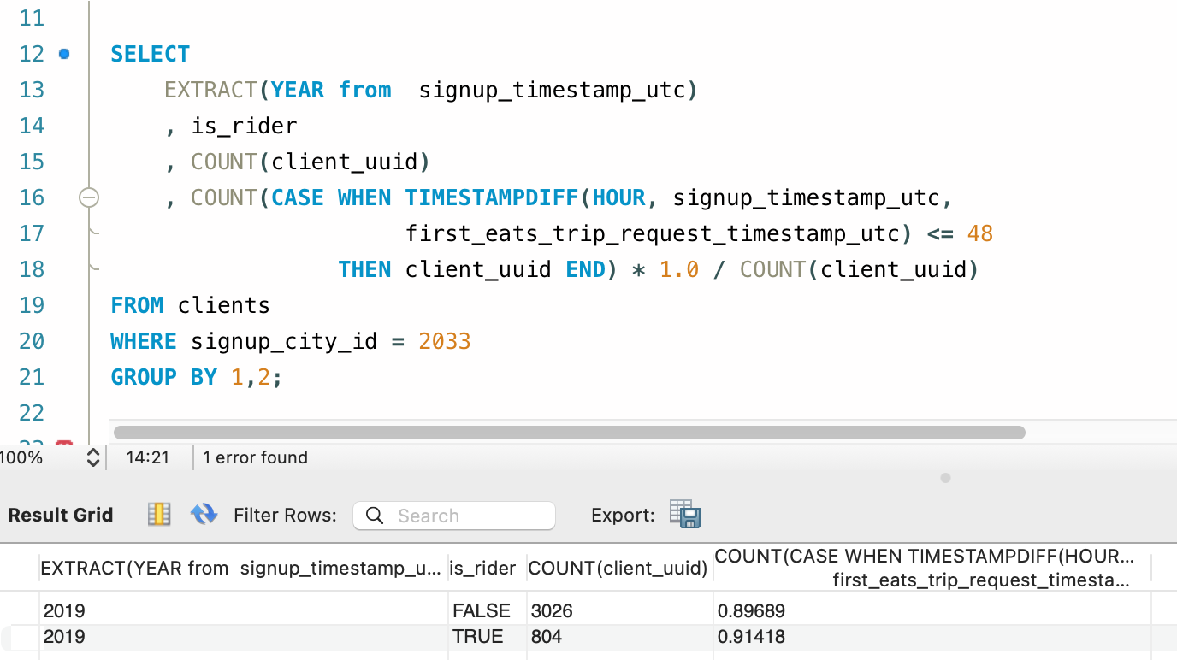
Task 2
About me
Achievements
Task 1
Task 2
Created Data Base
Query
Returns grouped by month and by whether it is rider or not, the proportion of clients who made their first order within 48 hours since they signed up

Slide 10
SELECT
EXTRACT(YEAR from signup_timestamp_utc)
, is_rider
, COUNT(client_uuid)
, COUNT(CASE WHEN DATEDIFF(EXTRACT(HOUR FROM signup_timestamp_utc),
first_eats_trip_request_timestamp_utc) <= 48
THEN client_uuid END) * 1.0 / COUNT(client_uuid)
FROM clients
WHERE signup_city_id = 2033
GROUP BY 1,2;
SELECT
EXTRACT(YEAR from signup_timestamp_utc)
, is_rider
, COUNT(client_uuid)
, COUNT(CASE WHEN DATEDIFF( signup_timestamp_utc,
first_eats_trip_request_timestamp_utc) <= 48
THEN client_uuid END) * 1.0 / COUNT(client_uuid)
FROM clients
WHERE signup_city_id = 2033
GROUP BY 1,2;
SELECT
EXTRACT(YEAR from signup_timestamp_utc)
, is_rider
, COUNT(client_uuid)
, COUNT(CASE WHEN TIMESTAMPDIFF(HOUR, signup_timestamp_utc,
first_eats_trip_request_timestamp_utc) <= 48
THEN client_uuid END) * 1.0 / COUNT(client_uuid)
FROM clients
WHERE signup_city_id = 2033
GROUP BY 1,2;
SELECT
EXTRACT(YEAR from signup_timestamp_utc)
, is_rider
, COUNT(client_uuid)
, COUNT(CASE WHEN DATEDIFF(EXTRACT(HOUR FROM signup_timestamp_utc),
EXTRACT(HOUR FROM first_eats_trip_request_timestamp_utc)) <= 48
THEN client_uuid END) * 1.0 / COUNT(client_uuid)
FROM clients
WHERE signup_city_id = 2033
GROUP BY 1,2;

Slide 11
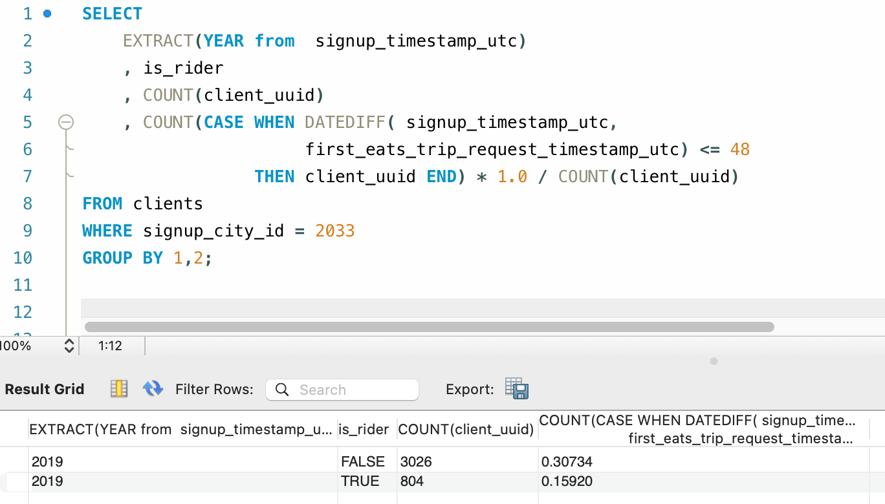

Slide 12
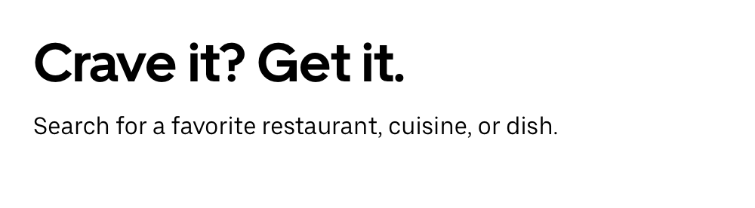
Task 2
About me
Achievements
Task 1
Task 2
17%
64% Frequent eaters
Active
660 eaters ordered at least once
Not rider
90.3%
36% Not frequent eaters
Total number of clients
3830
43% Frequent eaters
Previously rider
9.7%
Non- Active
83%
57% Not frequent eaters
3170 never ordered
45%
7.7%
Frequent active eaters (296)
Frequent total eaters
* Frequent eaters (>= 6 trips in their life as client)
Ironhack Final Project
API Data Extraction
Notes:
From the 660b active ones :
64 riders:
41 frequent (+6)
21 not frequent
596 not riders:
255 frequent
322 not frequent
Total frequent eaters: 296 (45% of the active ones) (7,73% of total clients)
Total non frequent eaters: 343 (55%)

Slide 13
Task 2
About me
Achievements
Task 1
Task 2
Defining churned clients
Weekly Evolution
Python + SQL (using “orders” table in database)
Steady increase in # of churned clients
Pike in first week of August
ACCESS TO CODE
Summer Holidays affecting
HERE
Slight reduction in September
*https://github.com/dgomezlechon/Ubereats.git
Notes:
#2017 different clients in total

Slide 14
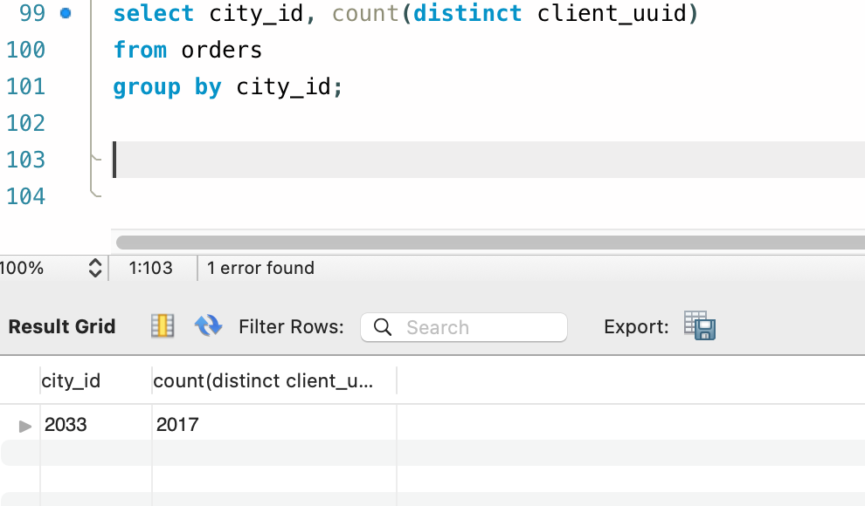
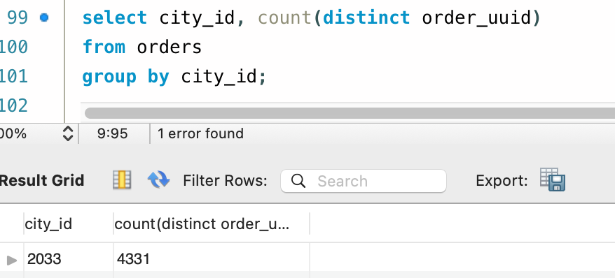

Slide 15
select
EXTRACT(WEEK from eater_request_timestamp_utc) as week_number,
client_uuid,
city_id,
count(case when TIMESTAMPDIFF(DAY,"2019-04-10 00:00:00",eater_request_timestamp_utc)>28
then client_uuid END )
from orders
WHERE city_id = 2033
group by 1,2
order by week_number asc;
select
EXTRACT(WEEK from eater_request_timestamp_utc) as week_number,
city_id,
count(case when TIMESTAMPDIFF(DAY,"2019-04-10 00:00:00",eater_request_timestamp_utc)>28
then client_uuid END )
from orders
WHERE city_id = 2033
group by 1
order by week_number asc;
select
city_id,
count(distinct case WHEN TIMESTAMPDIFF(DAY,eater_request_timestamp_utc,'2019-09-23')>28
AND TIMESTAMPDIFF(DAY,eater_request_timestamp_utc,'2019-09-16')<28
then client_uuid END )
from orders
WHERE city_id = 2033;

Slide 16
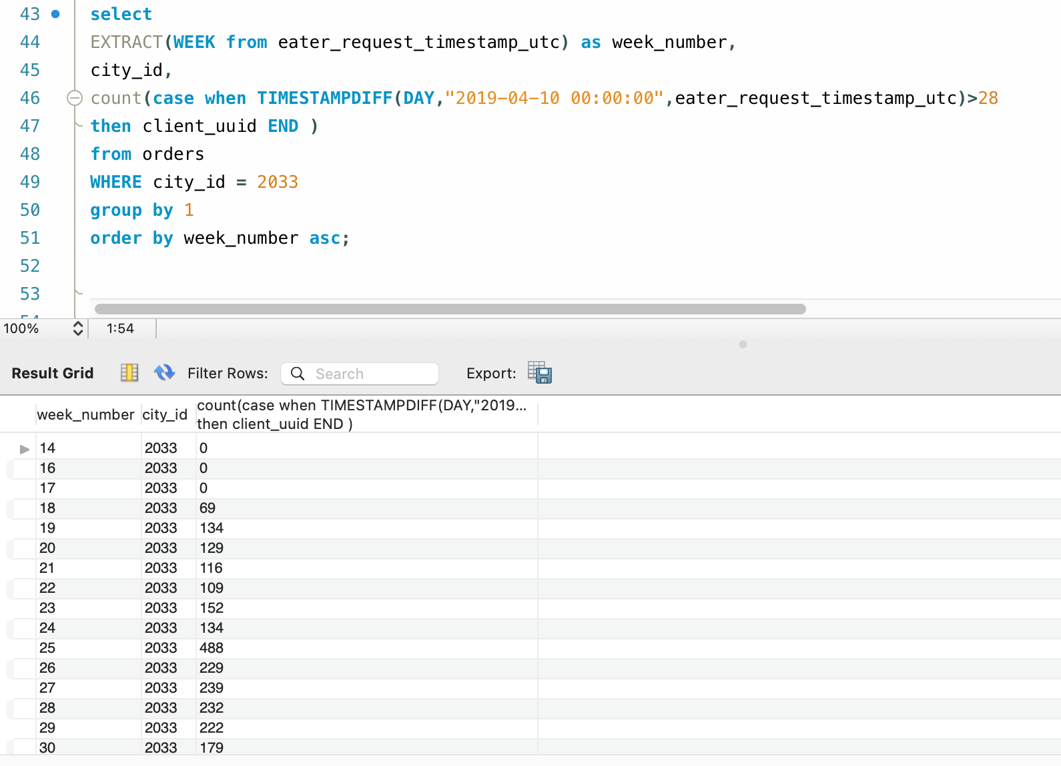

Slide 17
THANK YOU

